Slide 1
SDAD Ethics Refresher
Sallie Keller and Stephanie Shipp
June 13, 2019
Notes:
As part of your research, how many of you prepare and submit Institutional Review Board protocols?
I have completed dozens in my research over the last several years. And to be honest, I always thought of them as an administrative step to checkoff the list as a research project began.
But as I began to work more in the Big Data / All Data space, I began to realize that this is not just a necessary first step, but an activity that needs to be part of every research step.
The Institutional Review Board (IRB) is an administrative body established to protect the rights and welfare of human research subjects recruited to participate in research activities conducted under the auspices of the institution with which it is affiliated.
Abstract - The all data revolution has transformed the conduct of social science research, but the ethical dimensions should not be compromised. Researchers can now observe behavior based on repurposing existing data without consent or awareness by those providing the data. However, the principles set forth in the Belmont Report on Ethical Principles and Guidelines for the Protection of Human Subjects of Research are still as applicable as when these principles were first established in 1978. These principles emphasize responsibility to produce results that will benefit society. The principles are fairness (understand, mitigate, and communicate the presence of bias in both data practice and consumption); benefit (weighing risks and benefits of study); openness (practice humility and openness); transparent practices (community engagement, responsible communications); and reliability (ensure that every effort is made to understand the data and results). These Belmont principles should be exercised continuously and rigorously as researchers take on the challenge of repurposing data to answer new questions.
Discussions about ethics need to be a natural part of every research project, especially when repurposing data for analytical purposes. A publicly-shared ethical checklist at each research stage can help researchers identify and frame any potential concerns and evaluate their relative impacts. The checklist should cover all phases, from project selection and scoping to building a team, data discovery and acquisition, analysis, and implementation of results. A key part of this checklist is the assessment of implicit biases throughout the project, such as, what biases do the researchers have? Are biases introduced in the study through the choice of variable selection, like including males but not females or other genders? Are the right tools being used? Are methods and outputs transparent? The ethical principles involved here require the implementation of everyday practices around documentation, transparency, ongoing discussion, questioning, and constructive criticism.

Slide 2
“Science is not a major or a career. It is a commitment to a systematic way of thinking, an allegiance to a way of building knowledge and explaining the universe through testing and factual observation.”
Atul Gawande, 2016

Slide 3
Outline
Scientific Ethics
Scientific Ethics in the Context of Data Science

Slide 4
Replace “Physics” with your science
Each physicist is a citizen of the community of science.
Each shares responsibility for the welfare of this community.
Science is best advanced when there is mutual trust, based upon honest behavior, throughout the community.
Acts of deception, or any other acts that deliberately compromise the advancement of science, are unacceptable.
Honesty must be regarded as the cornerstone of ethics in science.
Professional integrity in the formulation, conduct, and reporting of physics activities reflects not only on the reputations of individual physicists and their organizations, but also on the image and credibility of the physics profession as perceived by scientific colleagues, government and the public.
It is important that the tradition of ethical behavior be carefully maintained and transmitted with enthusiasm to future generations.
https://www.aps.org/policy/statements/02_2.cfm

Slide 5
Our obligations as scientists
Obligation to honor the trust that our colleagues place in us
Obligation to ourselves
Obligation to act in ways that serve the public

Slide 6
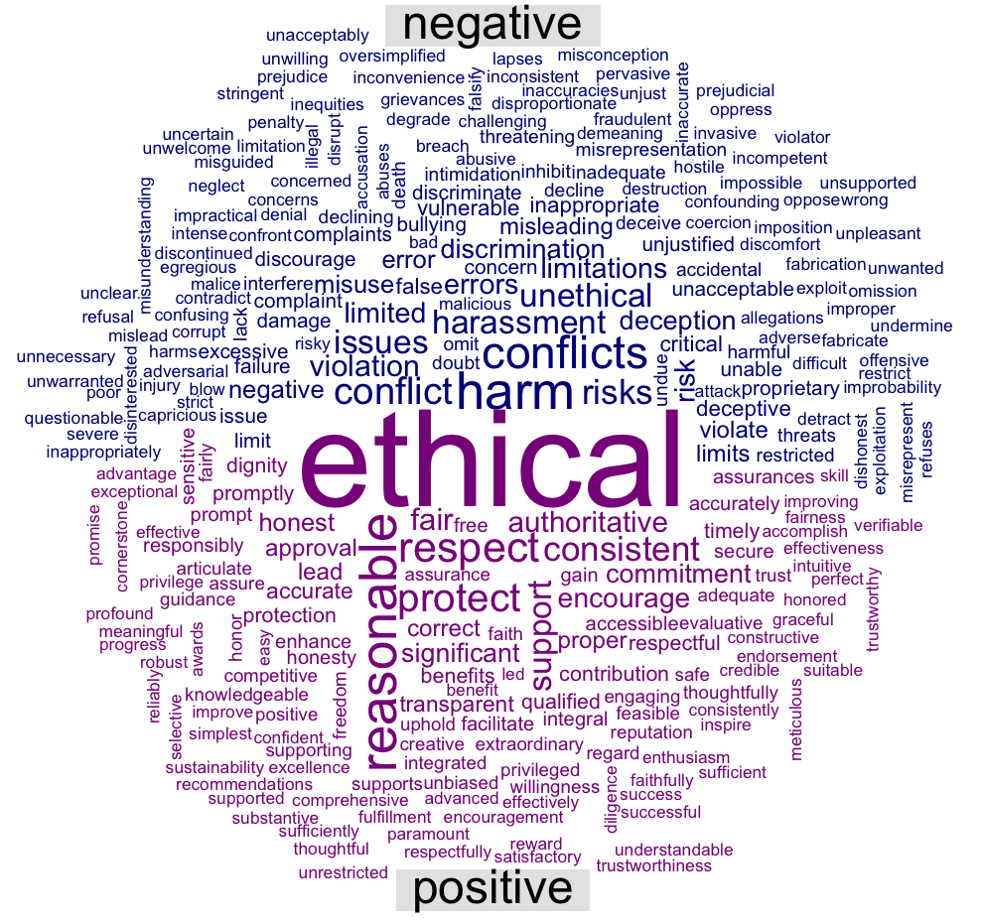
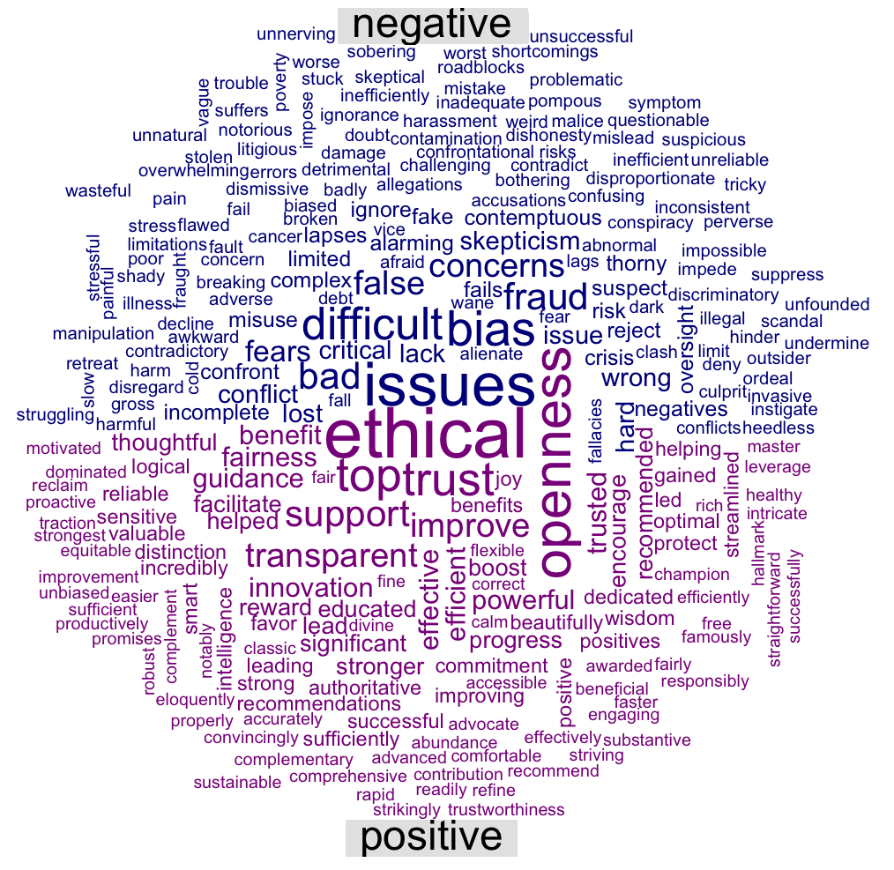
What you have read
Professional Society Codes Articles

Slide 7
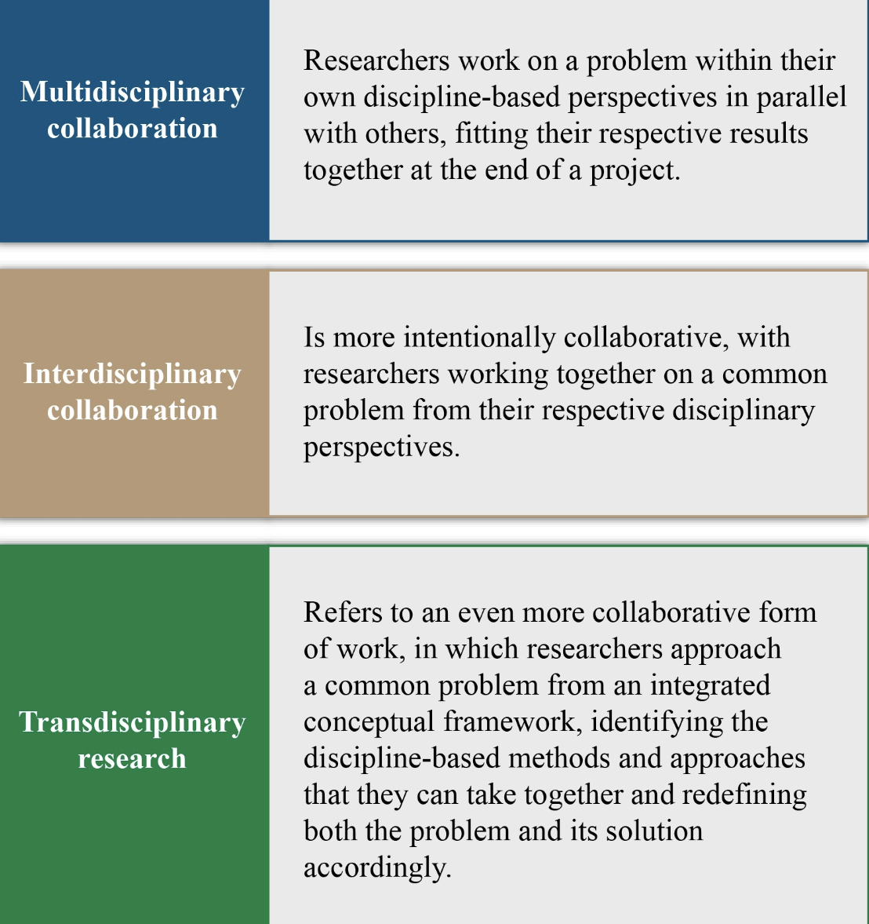
Collaboration

Slide 8
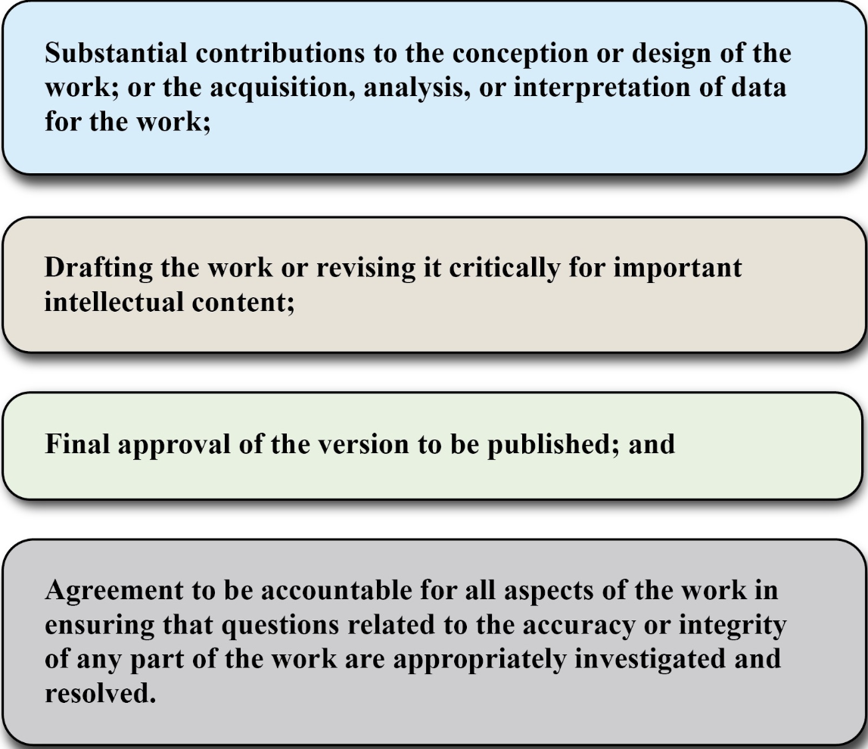
Collaboration – Responsible Authorship

Slide 9
Important actions to understand
Falsification
Fabrication
Plagiarism
What should you do?
UVA Research Integrity Officer
https://uvapolicy.virginia.edu/policy/RES-004

Slide 10
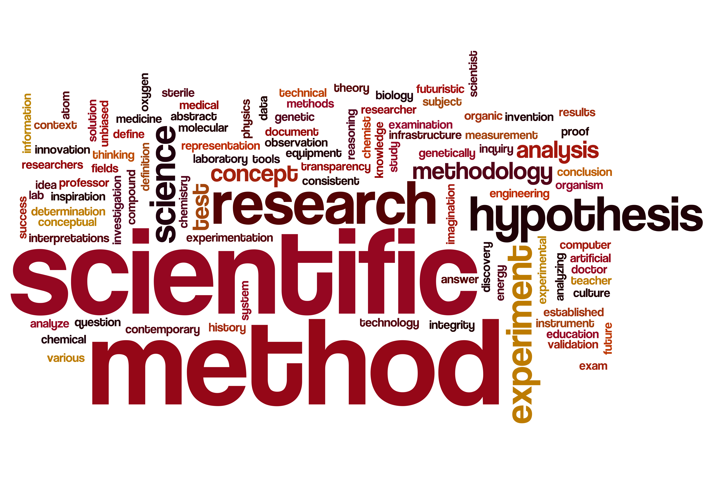
From the perspective of the Scientific Method

Slide 11
Basic Steps of the Scientific Method
Observe
Bench scale experiments observe neurotransmitters are associated with depression
Develop question ➔ Hypotheses
What if we alter these neurotransmitters, will it alleviate the symptoms of depression?
There is no difference in depression symptoms between the control group receiving the placebo and the treatment group receiving the new antidepressant drug
Design an experiment (replicate)
Randomly select sample from target population (adults suffering from depression) and randomly assign them to receive a control (placebo) or treatment (new drug)
Collect data (reproduce)
Analyze the data (reproduce)
Exploratory and confirmatory data analysis and inferential modeling.
Report conclusions (generalize) - Inferences extend to target group
Back to the drawing board

Slide 12
In the context of the Clinical Trial
Generalizability refers to inferring from a sample to a target population - inductive reasoning - makes broad generalizations from specific observations (sample) to the target population
Replication: can the entire process be replicated by the same or different lab under identical conditions
Reproducibility: can the exact numerical results and inferences be reproduced by reanalyzing the same data
Would the person reanalyzing the data make the same decisions regarding outliers, transformations, modeling, analyses methods, etc. etc

Slide 13
What about In the context of a policy study
What happens when complex policy interventions are cast as simple treatments and the scientific method is employed?
The context in which the policy intervention takes place is the key to understanding when, how, for whom, and to what extent an intervention can be replicated and the results generalized.
Notes:
Context = demographic characteristics of the setting and the people in it, material and economic features, institutional and organizational climate, interpersonal dimensions or typical means of interactions and noms for relationships in the setting, and the political dynamics of the setting including issues and interests.

Slide 14
Basic Steps in the Context of ALL Data
Observe
Set social context for issue to be studied, articulate action space
Develop question
Literature and best practices help formulate and refine questions, hypotheses, and shape data discovery process
Design Experiment (replicate)
Data discovery process
Collect data (reproduce)
Data acquisition approach, data sharing agreements, etc.
Analyze the data (reproduce)
Disciplined approach to data repurposing, model development, fitness-for-use assessments
Report conclusions (generalize)
Back to the drawing board

Slide 15

“Data Science”
Data science is a powerful unifier across disciplines because data science is about solving real problems using data.
Data science is a team sport.
Ethics is the responsibility of the entire team!
Notes:
We are a data science research group, that is part of the BII at UVA.
Our Social and Decision Analytics Division started almost 6 years ago.
As you know, Data Science is a Team Sport.
To solve these problems takes a team – it takes a variety of skills and ways of looking at the world to address OPPs creatively and in new ways.
And when you work with researchers in other disciplines, it helps to walk a mile in their shoes to better understand their perspectives.
These are our shoes and as you can see we are very diverse and creative ☺

Slide 16
Ethics is an integral part of the Data Science Framework
Notes:
Our research is guided by our Data Science Framework that forms the foundation of our research process.
The purpose of the Data Science Framework is to define repeatable and measurable processes for the use and repurpose of existing data sources to support our research questions.
This ethics review is tightly integrated into the Data Science Framework as shown in the figure.
Ethics touches every component and step in the practice of data science. We use an ethics checklist that we adapt to the project at each research stage to help researchers identify and discuss any potential ethical concerns and evaluate their ethical impacts.

Slide 17
Definitions
Privacy refers to the amount of personal information individuals allow others to access about themselves
Confidentiality is the process that data producers and researchers follow to keep individuals’ data private
Security applies to data storage and transport
Privatization of Data is the collection, aggregation, and (re)processing of personal data to sell to researchers, marketers, and others
Notes:
Definitions about privacy, confidentiality, security, and privatization of data are a starting point for discussions about ethics.
However, these definitions are not sufficient by themselves for ensuring ethical decision-making and activities.
Today, we can observe behavior based on repurposing existing data without consent or awareness by those providing the data.
This requires a broader view of ethics that adapts to the spirit as well as rules.

Slide 18
The Belmont report
The Belmont Principles provide the foundation for the Institutional Review Board (IRB) process and for a principles-based approach to ethics.
Respect for persons – honoring individual wishes
Beneficence – weighing risks and benefits of study
Justice – fair distribution of risks and benefits
Led to the Common Rule which governs U.S. Government research
Focus is on “research involving human subjects”
1979
Notes:
The Belmont Commission was convened after ethical failures by researchers became know.
The most famous example of one of these failures is the Tuskegee Syphilis Study conducted from 1932-1972 to observe the natural progression of untreated syphilis of poor African-American men.
None of the men were told that they had the disease, and none were treated with penicillin even after the antibiotic was proven to successfully treat syphilis.
The Belmont Commission issued 3 principles for the conduct of ethical research
These principles are
Respect for persons – treating people as autonomous and honoring their wishes
Beneficence – understanding the risks and benefits of the study and weighing the balance between (1) do no harm and (2) maximize possible benefits and minimize possible harms.
Justice – deciding if the risks and benefits of research are distributed fairly
The principles were codified into law and are now referred to at the Common Rule.
The Belmont Report provided the foundation for the Institutional Review Board’s principles and focus on ‘research involving human subjects.”

Slide 19
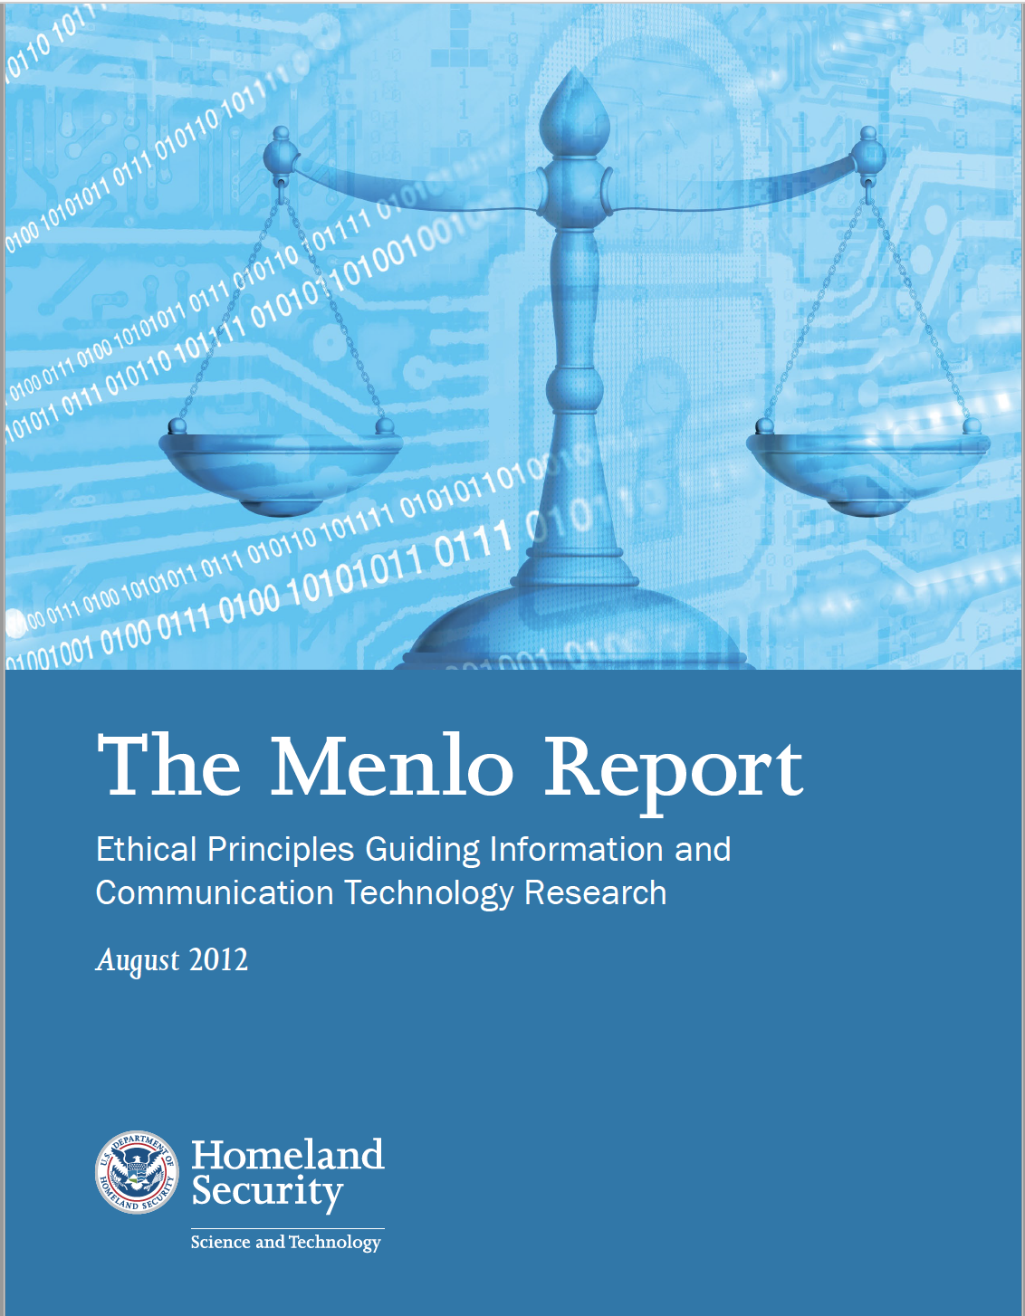
The Menlo Report
Department of Homeland Security commissioned a report to introduce Belmont principles in ICT (Information, Communication, Technology)
The Menlo Report extends the Belmont Principles to include Respect for Law and Public Interest
Focus is on “research with human-harming potential”
2012
Notes:
The Menlo report was commissioned by the Department of Homeland Security to bring the Belmont principles to the Information, Communication, and Technology or ICT community.
They also expanded the Belmont principles in two important ways:
They added a 4th principle - Respect for Law and Public Interest – extends principle of beneficence to include all relevant stakeholders
And they expanded the focus to include “research with human-harming potential,” not just a focus on “research on human subjects.”
This change is important in the digital age where the use of digital technologies and repurposing of data can expose people to risks.

Slide 20
Principles-based approach to ethics for all disciplines
Allows researchers to make decisions and communicate their decision process for cases where rules do not yet exist
Emphasizes responsibility and methods expected to produce results that will benefit society
Notes:
Echoing Matthew Salganik in his book, Bit by Bit, we propose a Principles-based approach to ethics for all disciplines.
This approach allows researchers to make decisions and communicate their decision process based on current rules and adapt them for cases where rules do not yet exist
A principle-based approach emphasizes responsibility and methods expected to produce results that will benefit society
Even though our IRB processes still only focus on the principles set forth in The Belmont Report, our projects should embrace the broader criteria set forth in the Menlo Report.
Social scientists can lead the way
https://www.bitbybitbook.com/en/1st-ed/ethics/digital-is-diff/ (online copy of the book)

Slide 21
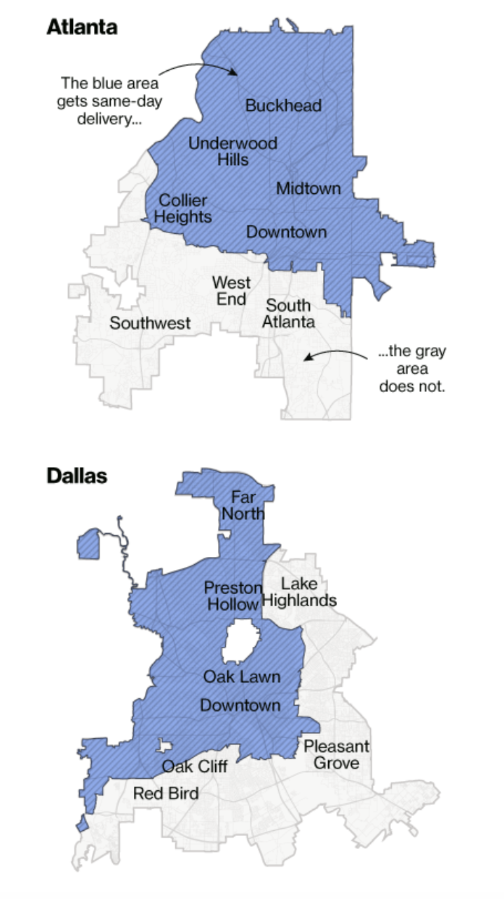
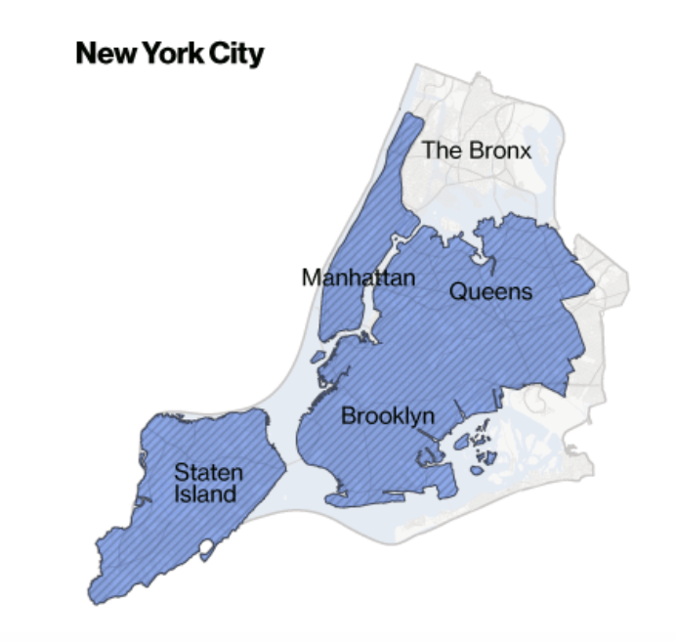

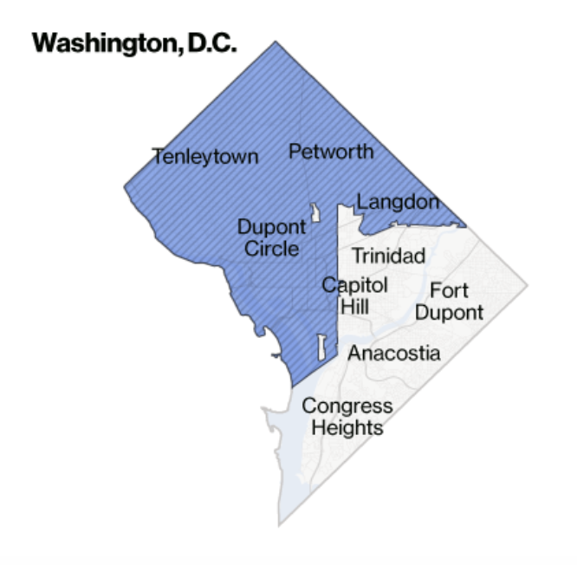

Why ethics? A cautionary note
April 21, 2016
Source: https://www.bloomberg.com/graphics/2016-amazon-same-day/
Notes:
You might ask why ethics needs to be explicitly incorporated into the research discussion throughout the life of the project.
Let me answer this with an example.
Amazon algorithmically determined which neighborhoods would get Prime Same Day delivery.
They did not consider race, yet the data mapped almost perfectly by race.
The blue areas are the ones that get same day delivery and white areas are primarily black neighborhoods that were not planned for SAME DAY DELIVERTY.
So even though the algorithms did not use race, the data picked up the social biases, ….. and perhaps they should have used race.

Slide 22
Refinement of Community principles for ethical data sharing
Fairness - Understand, mitigate and communicate the presence of bias in both data practice and consumption
Benefit - Set people before data and be responsible for maximizing social benefit and minimizing harm
Openness - Practice humility and openness, i.e., transparent practices
Reliability - Ensure that every effort is made to glean a complete understanding of what is contained within data, where it came from, and how it was created
Notes:
The Community Principles on Ethical Data Sharing were formulated at a Bloomberg conference in 2017.
The four principles are:
fairness to reduce bias;
maximizing societal benefits and minimizing harm;
maintaining open and transparent processes
ensuring complete understanding of the data including how it was born and its quality.
These principles are a reframing of the Belmont and Menlo Principles into everyday language.
These principles were developed to embed ethics into projects.
The Bloomberg community advises us to implement these principles, while exercising “ethical imagination in our work”
To implement these four principals, the community recommends obtaining consent to use the data; maintaining data securely; ensuring anonymity of the data; providing sufficient documentation of practices to be transparent through the data lifecycle; acknowledging and addressing bias or potential bias; demonstrating an understanding of tensions across stakeholders (if they exist); and taking care to communicate carefully; all while “exercising ethical imagination in their work, including considering the implication of what came before and what may come after, and actively working to increase benefit and prevent harm to others.” (CPED 2017).

Slide 23
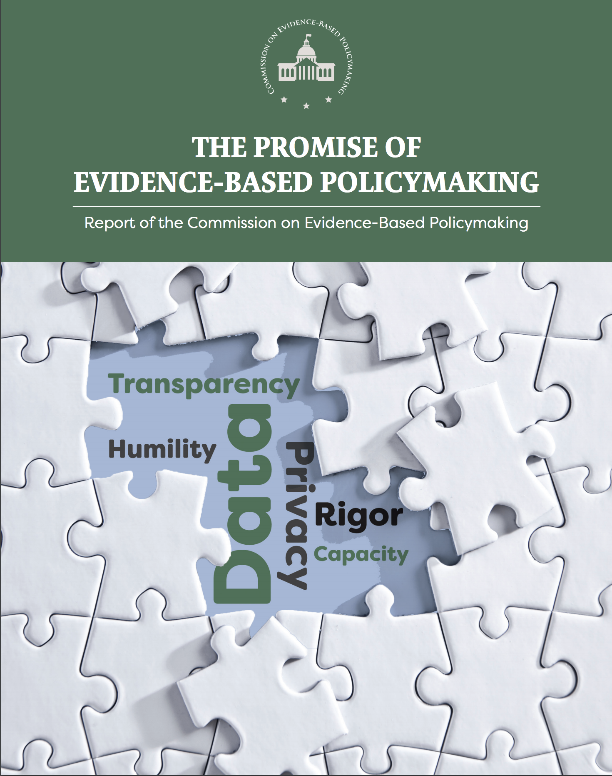
What about informed consent?
“Access to data held by the government should occur only in service to the public interest. Decisions about allowing data access must be calibrated according to a project’s potential public benefits, the sensitivity of a particular dataset, and any risk that allowing access could pose to confidentiality. Access can and should be restricted to eligible individuals who demonstrate an understanding of their obligations for data stewardship.”
Murray/Ryan Commission on evidence-based policy making, 2017
Notes:
The Evidence-Based Policymaking Commission that met in 2016-2017 also reinforces a principles-based approach to data access and ethics.
Ideally, access to administrative government data should only occur if it is to be used in service to the public good.
Related to the Commission’s findings, the Foundations for Evidenced-Based Policymaking Act of 2017 was signed into law in mid-January.
The legislation requires each federal agency to set up a chief data officer, who is responsible for managing the agency's data assets and promoting how best to use them.
It also require federal agencies to look at how to enhance data privacy, including when personally identifiable information is involved.
Both Bloomberg and the EBP commission advocate for informed consent but that may sometimes be challenging if the data are to be useful.
Legislation such as HIPPA (Health Insurance Portability and Accountability Act of 1996) allow for data to be used for statistical purposes as long as privacy and confidentiality of the data are not disregarded.

Slide 24
IRB: Waivers of the elements of consent
Federal regulations allow IRBs to authorize researchers to modify the consent process by omitting one or more elements of information or to provide no information at all. The waiver or alteration of any or all of the elements of consent can be authorized only if these criteria are met.
The research involves no more than minimal risk to the subjects
The research could not practicably be carried out without the requested waiver or alteration
If the research involves using identifiable private information or identifiable biospecimens, the research could not practicably be carried out without using such information or biospecimens in an identifiable format (new under the 2018 Common Rule)
The waiver or alteration will not adversely affect the rights and welfare of the subjects
Whenever appropriate, the subjects or legally authorized representatives will be provided with additional pertinent information after participation
Where the participants are members of a cultural group in which signing forms is not a normal/acceptable practice (new under the 2018 Common Rule)
IRB for Social/Behavior/Education Research: RESEARCH THAT DOES NOT INVOLVE PRISONERS
Notes:
Related to Informed Consent
There are times when obtaining consent could jeopardize the results or people in the study.
These are when knowing you are part of a study changes behavior, or the study would not be useful without the identification of the purpose, e.g. in the case of biospecimans; or unintended release of names could put the people in the study at risk.
Confidentiality concerns here.
Archival data

Slide 25

Criteria for data science project checklist
Adapt criteria to ensure the spirit and implementation of ethical principles into the research
Make ethical considerations and discussion of implicit biases an active and continuous part of the project
Seek expert help when ethical questions at any stage cannot be answered by the research team
Incorporate ethical guidelines from relevant professional societies, e.g., American Statistical Association, American Physical Society, Association of Computing Machinery
Ensure documentation, transparency, ongoing discussion, questioning, & constructive criticism throughout the project
Notes:
Every research project should include a Data Science Ethics checklist at each phase of the project.
A key part of this checklist is the assessment of implicit biases throughout the project.
The ethical principles involved here require instilling ethics into all data science research practices that is reflected in project documentation, transparency, ongoing discussion, questioning, and constructive criticism.
A publicly-shared ethics checklist starts with the project planning phase that encompasses the entire project, not just completion of the Human Research Protections Program IRB process.
The IRB approval is necessary but not sufficient for addressing a researcher’s ethical responsibility in his/her research.
The checklist provides a mechanism to ensure that ethical principles be discussed throughout the project informally and formally at specific milestones.

Slide 26
Ethics Checklist for Data Science Research Projects
Project Initiation: Recognize and affirm that all project plans will incorporate regular checks, discussion, and documentation to ensure adherence to the ethical principles of research.
Problem Identification (Relevant Theories and Working Hypotheses): Establish the ethical basis for undertaking the project as well as to establish the project requirements to protect research participant welfare, and the equitable allocation of all potential project benefits and risks.
Data Discovery, Inventory, Screening, & Acquisition: Consider potential biases that may be introduced through the choice of datasets and variables.
Data ingestion and Governance: Put in place data platforms and processes to ensure data transfer, storage, and database development adheres to data governance agreements and best practices for data quality assurance.
Statistical Modeling and Analysis: Establish and implement processes to document methods, results and limitations.
Fitness-for-Use Assessment: Critically asses the overall utility of the results in achieving the predicted benefits of the study, to be transparent about potential limitations of the study, and to ensure that unintended biases haven’t been introduced as a result of data choice and model refinement.
After-project Debriefing: Summarize questions and actions taken during the project, to reinforce the process of ethical consideration on all continuing and future projects. Establish adequate protocols of information dissemination, to ensure the replication and expansion of the research findings.
Notes:
This is an example of a general Ethics Checklist that can be adapted to a specific data science projects that use and integrate repurposed data.
We developed an Ethics Checklist that can be modified to each project.
We recommend doing this as a team to gain buy-in and recognition of the importance of ethics in our research.
The goal is for ethics to move from a peripheral concern to a central concern.
It is not just about completing the IRB and then you are done!
ETHICS NEEDS TO BE INTEGRATED INTO EVERY FACET OF THE RESEARCH PROCESS through formal and informal discussions.

